Slide 1
Java I/O streams

Slide 2
Java I/O
Data is retrieved from an input source. The results of a program are sent to an output destination.
Devices are all handled by the same abstraction: the stream.
A stream is a logical entity that either produces or consumes information.
A stream is linked to a physical device by the Java I/O system.
All streams behave in the same manner, even if the actual physical devices they are linked to differ.

Slide 3
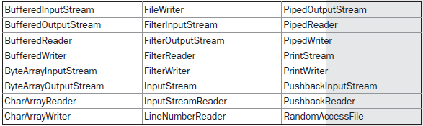
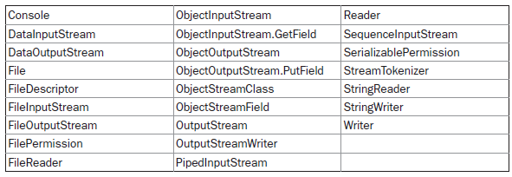
Java io classes

Slide 4

Java io interfaces

Slide 5
File
class FileDemo {
static void p(String s) {
System.out.println(s);
}
public static void main(String args[]) {
File f1 = new File("/java/COPYRIGHT");
p("File Name: " + f1.getName());
p("Path: " + f1.getPath());
p("Abs Path: " + f1.getAbsolutePath());
p("Parent: " + f1.getParent());
p(f1.exists() ? "exists" : "does not exist");
p(f1.canWrite() ? "is writeable" : "is not writeable");
p(f1.canRead() ? "is readable" : "is not readable");
p("is " + (f1.isDirectory() ? "" : "not" + " a directory"));
p(f1.isFile() ? "is normal file" : "might be a named pipe");
p(f1.isAbsolute() ? "is absolute" : "is not absolute");
p("File last modified: " + f1.lastModified());
p("File size: " + f1.length() + " Bytes");
}
}
File Name: COPYRIGHT
Path: /java/COPYRIGHT
Abs Path: /java/COPYRIGHT
Parent: /java
exists
is writeable
is readable
is not a directory
is normal file
is absolute
File last modified: 812465204000
File size: 695 Bytes

Slide 6
The Stream Classes
Java’s stream-based I/O is built upon four abstract classes: InputStream, OutputStream, Reader, and Writer.
InputStream and OutputStream are designed for byte streams. Reader and Writer are designed for character streams.
The byte stream classes and the character stream classes form separate hierarchies.

Slide 7
Streams
InputStream is an abstract class that defines Java’s model of streaming byte input. It implements the Closeable interface. Most of the methods in this class will throw an IOException on error conditions.
OutputStream is an abstract class that defines streaming byte output. It implements the Closeable and Flushable interfaces. Most of the methods in this class return void and throw an IOException in the case of errors.

Slide 8
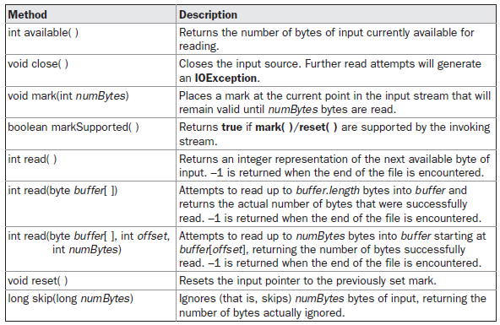
Input stream

Slide 9
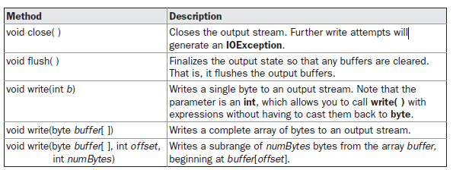
Outputstream

Slide 10
Read example
Example program class FileInputStreamDemo.pdf

Slide 11
Print Writter
public class PrintWriterDemo {
public static void main(String args[]) {
PrintWriter pw = new PrintWriter(System.out, true);
pw.println("This is a string");
int i = -7;
pw.println(i);
double d = 4.5e-7;
pw.println(d);
}
}
The output:
This is a string
-7
4.5E-7

Slide 12
Input output
class CopyFile {
public static void main(String args[]) throws IOException
{
int i;
FileInputStream fin;
FileOutputStream fout;
try {
try {
fin = new FileInputStream(args[0]);
} catch(FileNotFoundException e) {
System.out.println("Input File Not Found");
return;
}
try {
fout = new FileOutputStream(args[1]);
} catch(FileNotFoundException e) {
System.out.println("Error Opening Output File");
return;
}
} catch(ArrayIndexOutOfBoundsException e) {
System.out.println("Usage: CopyFile From To");
return;
}
try {
do {
i = fin.read();
if(i != -1) fout.write(i);
} while(i != -1);
} catch(IOException e) {
System.out.println("File Error");
}
fin.close();
fout.close();
}
}

